Slide 1

TODO Web APP
Prepared by
Eden Mengesha - 52844
Sofonias Aberra - 52877
Yonas Lemma -52962
Francis Okechukwu Olekamma - 53032

Slide 2

Introduction
This is a Todo web application built using JSP, Servlet, JDBC and MySQL database and a little bit of HTML for the user interface.
Through out this presentation screenshots and snip of the codes will be attached however full code will also be available in our GitHub accounts.

Slide 3
Functionalities of our Todo web application

Slide 4
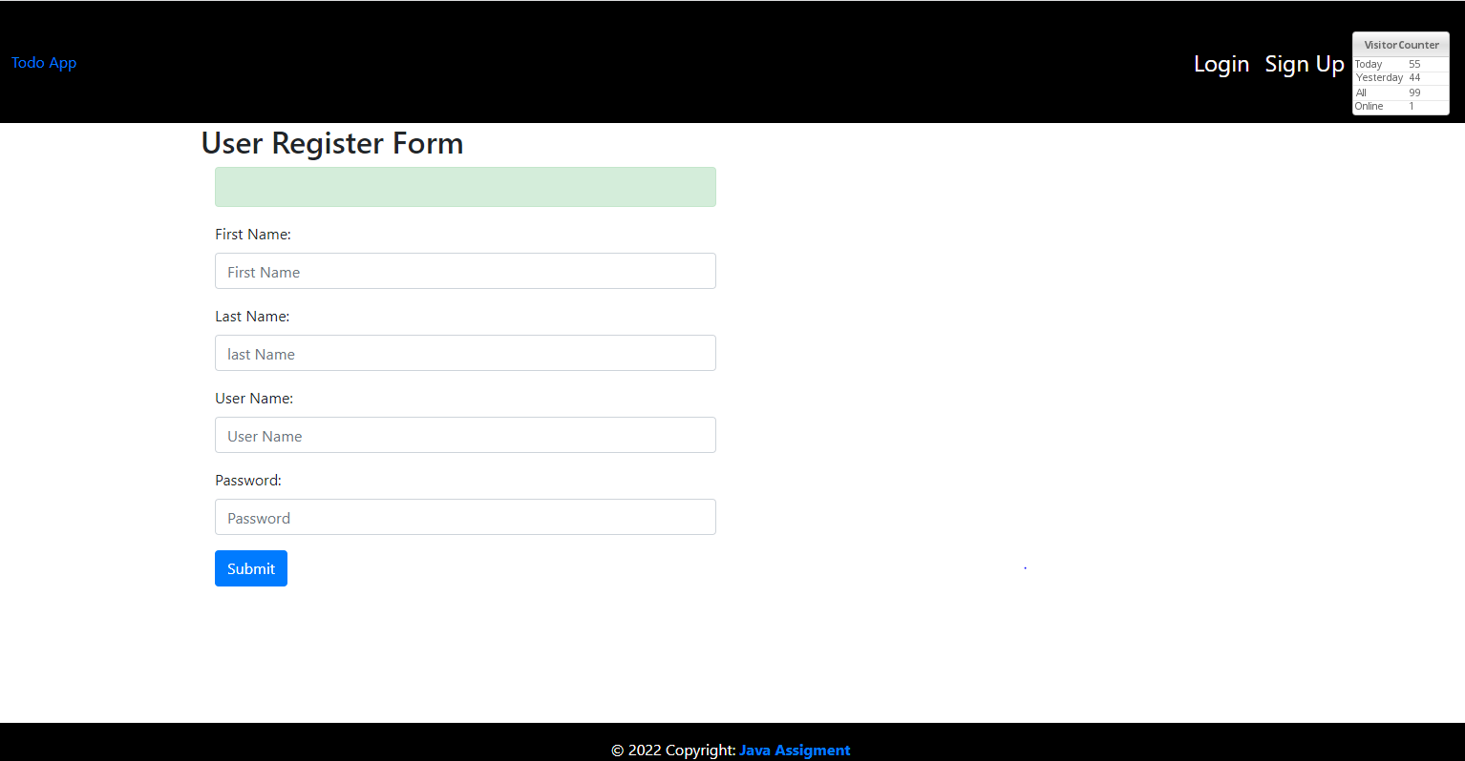
Sign Up page

Slide 5
Sign Up page
Out signup page contains areas to submit a Frist Name , Last Name, Username and Password.
Once user provides this information correct and clicks on submit the user will be a message that says user signed up successfully.
-The user must use the same password and username created here to log in as well
- After the user sees that message there will be a new user created in our data base as well. The code we used for the SQL and a screenshot will be provided in a diffract section of this power point (topic 3 )

Slide 6
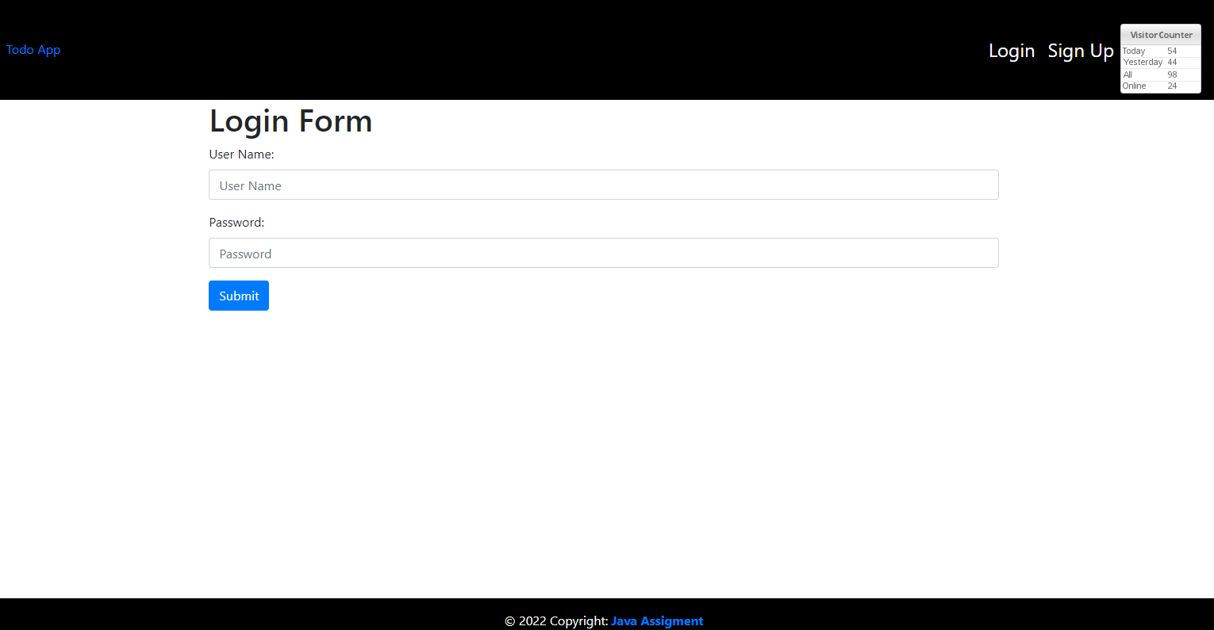
Login page

Slide 7
Login page header section
- As demonstrated in the above screen shoot on the left side of the log in page’s header section, it contains a button that says, “Todo APP” and if user clicks on it redirects the page to out website , the website contains a brief description of our team member and our motivation to creating this web application
- Towards the right part of the login pages header section, we have placed two buttons , Login and Sign up
Other that that we have also placed our visit counter on this area.
In the middle section the log in page contain an area for the user to put username and password created during the time of Sign up and to submit it >> after verification if the username and password matched the one created in the database the user will then be able to log in.
Login page footer section
The footer section (lower area) also contains a button that says, “java Assigment ” and if user clicks on it redirects the page to out website as well

Slide 8
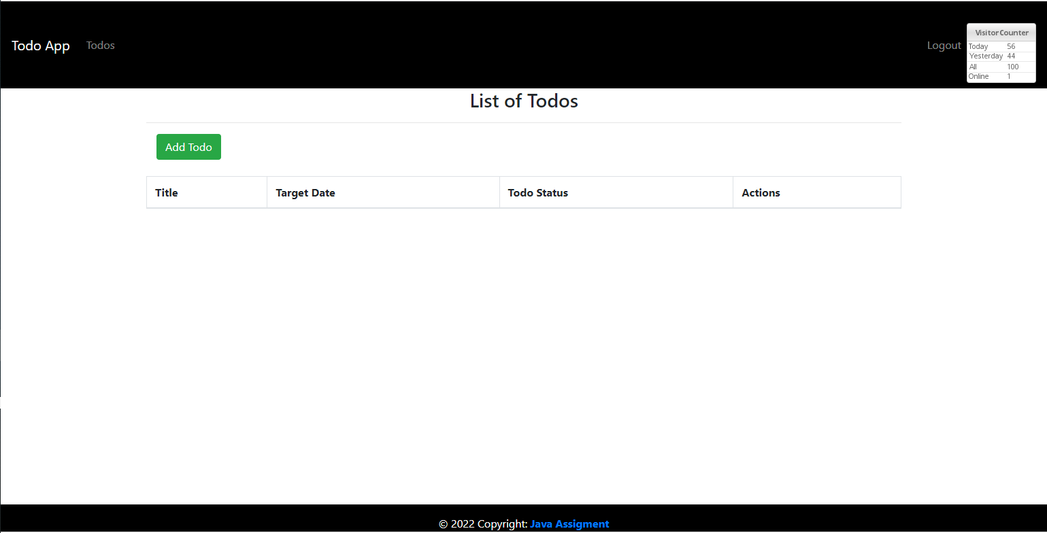
List of Todos
Once the user logs in this will be the page they see, in this area the user will also be able to click on the button that says “Add todo” and it will redirect the user to another age where they will be able to add there todo task.

Slide 9
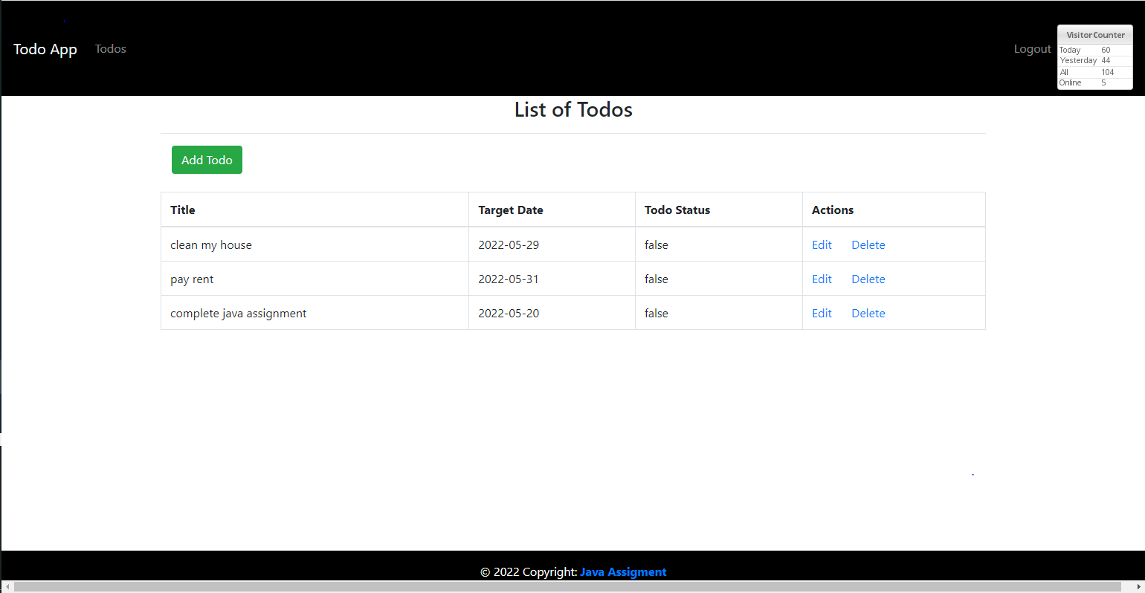
List of Todos
Once user inputs the Todo task they will be able to see all the tasks they have in this page , incase the user needs to edit or delete the task there is also options for that under Action. If the user has set the Status as InProgress it will show False under status and if the user marks the task as complete the status will show as complete as well so that the user will be aware of which tasks still needs to be done

Slide 10
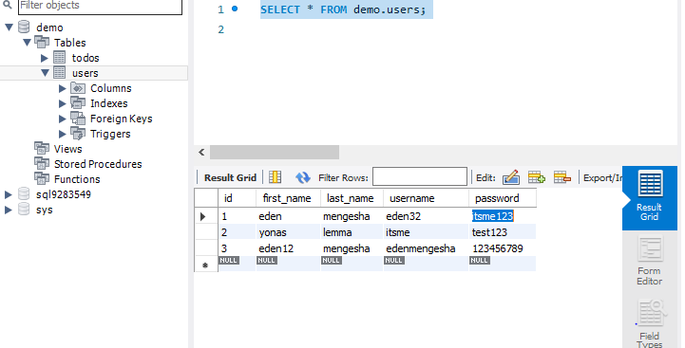
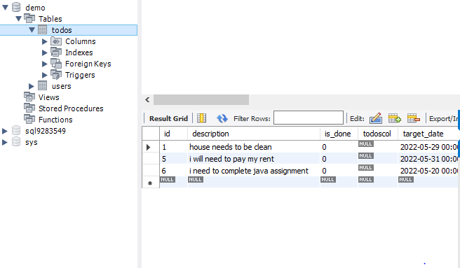
MYSQL
We have used mysql code in this assignment to register the users log in credentials and also to register all the todo tasks, as demonstrated on the screenshot below if the user decided to delete or edit the tasks it will also be removed or edited from the sql table
Users table to store log in credentials
To do task table

Slide 11
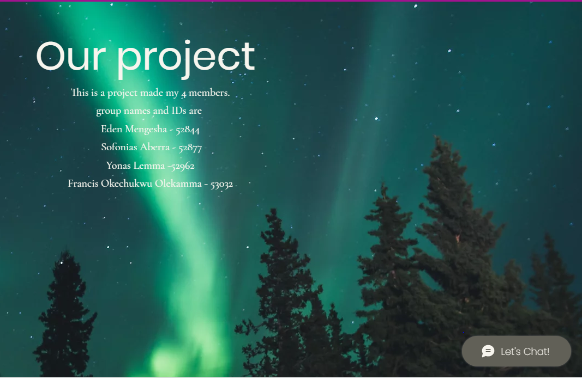
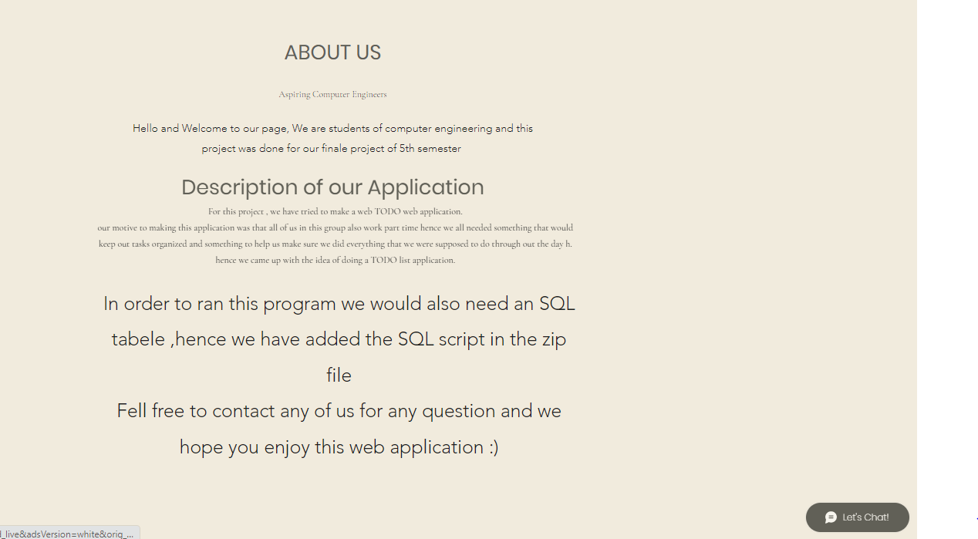
Our additional website prepared dive a brief description
User can get to this page by clicking on “todo” button on the header or “java assignment on the footer ”

Slide 12

Summary
Tools used
JSP - 2.2 +
IDE - Eclipse Neon.3
JDK - 1.8
Apache Tomcat - 8.5
Servlet API - 2.5
MySQL and mysql-connector-java-8.0.13.jar

Slide 13


Thank You
Eden Mengesha - 52844
Sofonias Aberra - 52877
Yonas Lemma -52962
Francis Okechukwu Olekamma - 53032

